Slide 1
Surrogate Measures of Safety Subcommittee ANB20(3)
99th TRB Annual Meeting

Slide 2
Opening
Introduction of participants
Discussion and approval of the 2019 meeting minutes

Slide 3
Updates from other TRB groups and International Associations
Transportation Safety Management (ANB10)
Geometric Design (AFB10)
Highway Safety Performance (ANB25)
Joint Subcommittee on Speed and Safety ANB20(5)
Future Directions in Safety Analysis ANB20(1)
International Co-operation on Theories and Concepts in Traffic Safety (ICTCT) - Aliaksei Laureshyn
SAE committee on Surrogate Measures of Safety - Aliaksei Laureshyn

Slide 4
Synthesis of Papers Related to SMoS
25 papers
4 main topics: Intersections and interchanges (9), pedestrians and non-motorized users (7), real-time safety analysis (4) and safety tool development (6)
Measures: traffic conflicts, TTC and PET
Data: video, simulation, vehicle/user trajectories, naturalistic driving data
Analysis: statistical regression, machine learning
Thanks to Bismarck Ledezma-Navarro

Slide 5
Research updates and presentations
Updates for the various FHWA-sponsored SHRP2 NDS and RID projects, Carol Tan (absent)
SSAM: Are we there yet?, Li Zhang
Indiana research on traffic conflicts method, Andrew Tarko
Surrogate Measures of Safety with a focus on Vulnerable Road users: An exploration of theory, practice, exposure and validity, Carl Johnsson

Slide 6
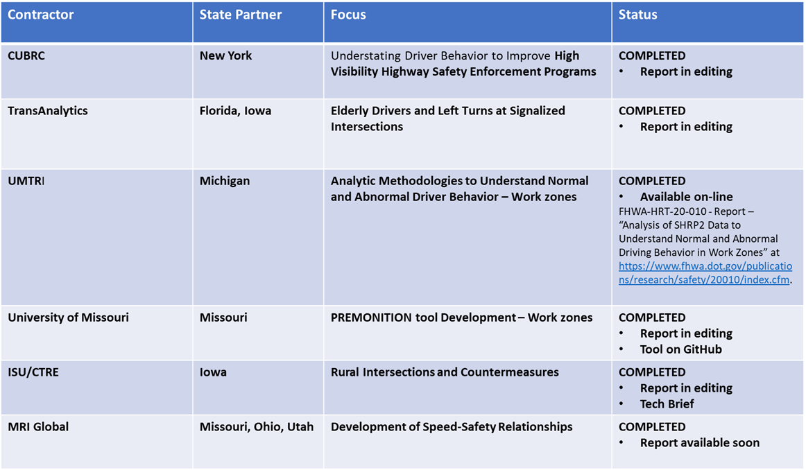
FHWA-sponsored SHRP2 NDS and RID projects
FHWA BAA (Broad Agency Announcements): sponsored directly from FHWA to the researchers
Phase 2 is the full research study, last phase

Slide 7
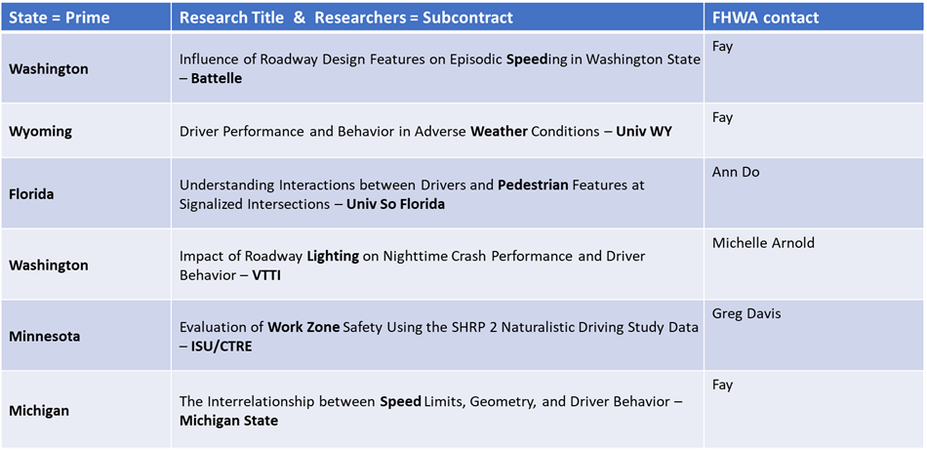
FHWA/AASHTO IAP
FHWA/AASHTO IAP (Implementation Assistance Program): more complicated funding structure
FHWA funds given to AASHTO to sponsor State DOT research; Phase 2 was full research project; Phase 3 is actual implementation

Slide 8
SHRP 2 Naturalistic Driving Study
The SHRP 2 Naturalistic Driving Study Pooled Fund: Advancing Implementable Solutions https://www.pooledfund.org/Details/Study/613 managed under the Transportation Pooled Fund Program, is sponsoring new research using data from the second SHRP 2 NDS
The research will address priority topics in the areas of Highway Safety, Operations, and Planning

Slide 9
SHRP 2 Naturalistic Driving Study
25 projects proposed ($8 million), only 6 projects were funded ($2.1 million)
Verification and Calibration of Microscopic Traffic Simulation using Driver Behavior and Car Following Metrics for Freeway Segments
Validation of Performance-Based Design
Investigating How Multimodal Environments Affect Multitasking Driving Behaviors
Developing Speed Crash Modification Factors (CMFs) using SHRP 2 data
Incorporating the Impacts of Driver Distraction into Highway Design and Traffic Engineering
Freeway Guide Sign Performance at Complex Interchanges: Reducing Information Overload

Slide 10
RID Reduced Datasets
11 reduced datasets developed: AADT, Intersection Width, Intersection Crashes, Curves, Curve Crashes, Homogeneous Segments, Speed Limit, Lanes, Divided/Undivided Segments, Roadway Attributes for All Crashes, Comprehensive LRS for all States
Additional four will be developed by end of 2021: Link-Based Crashes, Update Link Road Attributes, Relating Opposite Direction on Divided Highways, ARNOLD (“All Roads Network Of Linear referenced Data”, required by MAP-legislation as RID LRS layer)

Slide 11
Activities
New research directions, research needs statements and session/workshop ideas
Website, wiki, surveys and dissemination activities
Recent and upcoming books and chapters

Slide 12
Coming conferences, meetings, research opportunities
6th International Symposium on Highway Geometric Design, Amsterdam - The Netherlands, 28 June - 1 July 2020, featuring the Urban Streets Symposium
ICTCT extra workshop in Accra, 2-3 April 2020, and regular workshop in Berlin, 22-23 October 2020

