Slide 1
Surrogate Measures of Safety Subcommittee ACS20(3)
100th TRB Annual Meeting

Slide 2
Agenda
Opening remarks
Introduction of participants
Discussion and approval of the 2020 meeting minutes
Updates from liaisons with other TRB groups and International Associations
Surrogate measures at the 100th TRB Annual Meeting
Research updates and presentations
Brainstorming in breakout sessions
Coming conferences, meetings, research opportunities and other matters
Adjourn

Slide 3
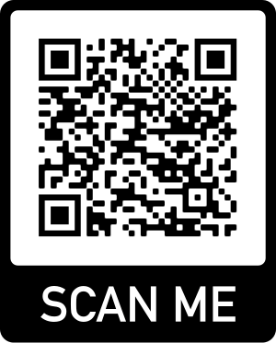
Opening
Merging of ANB20 and ANB25 into ACS20
Introduction of participants in breakout rooms (5 min)
Discussion and approval of the 2020 meeting minutes
← Attendance sheet
Sign-up on our website to be on the mailing list: https://sites.google.com/site/surrogatesafety/mailing-list-sign-up
(thanks to Derek Troyer)
Notes:
Introduce yourself
Discuss how this unusual meeting is going, how long you have attended TRB

Slide 4
Updates from Other TRB Groups and International Associations
Transportation Safety Management Systems (ACS10)
Performance Effects of Geometric Design (AKD10)
Subcommittee on Safety Analytical Methods (ACS20(1)) - Xiao Qin
Other TRB committees?
International Co-operation on Theories and Concepts in Traffic Safety (ICTCT) - Aliaksei Laureshyn
SAE committee on Surrogate Measures of Safety - Aliaksei Laureshyn

Slide 5
SMoS at the 2021 Meeting
23 submitted papers
7 poster sessions
~ 11 papers in session 1202 Safety Performance and Analysis, Act 2: Surrogates, Conflicts, and Other Safety Data
Also applied to bicycles, buses, AVs
Notes:
Using Bus Driving Events as Surrogate Safety Measures for Pedestrian and Bicycle Based on GPS Trajectory Data
Cyclist Behaviour Towards Stop Signs. A Before-After Study on Stop-Controlled Intersections Using Video Trajectory and Surrogate Methods
Predicting crash risk in real-time using vehicle trajectory and Surrogate Safety Measures
Study of Automated Shuttle Interactions in City Traffic Using Surrogate Measures of Safety
Evaluating Safety Performance of the Offset Diamond Interchange Design using VISSIM and Surrogate Safety Assessment Model
Video-based Network-wide Surrogate Safety Analysis to Support a Proactive Network Screening Using Connected Cameras: Case Study in the City of Bellevue (WA) United States

Slide 6
Research Updates and Presentations
Indiana research on traffic conflicts, Andrew Tarko
Traffic simulation for surrogate measures of safety: collaboration with SimSub, Christopher Melson
Update on network wide safety assessment in the City of Bellevue, Franz Loewenherz
NCHRP 17-86: Estimating Effectiveness of Safety Treatments in the Absence of Crash Data, Bhagwant Persaud

Slide 7
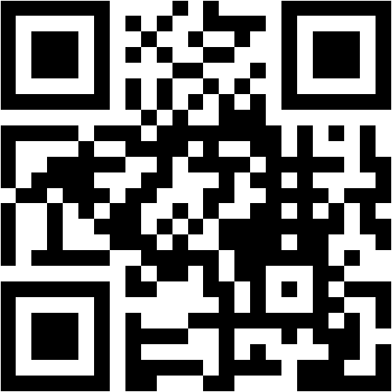
Brainstorming in Breakout Groups
New research directions, research needs statements and session/workshop ideas
Website, wiki, surveys and dissemination activities
Short poll https://www.menti.com/usento1nnw

Slide 8
Brainstorming in Breakout Groups
New research directions, research needs statements and session/workshop ideas
Website, wiki, surveys and dissemination activities
Choose a rapporteur
Use slides for note taking
Report to everyone at the end
Group 1 | Group 2 | Group3
New research directions, research need statements | Webinars, workshops, and calls for papers | Outreach and dissemination New directions for subcommittee
Start on slide 9 | Start on slide 12 | Start on slide 15
Notes:
https://docs.google.com/presentation/d/1amFYwyjB7vtgXp0SvndKsJ1kyxkyalFWoTMGwj623hw/edit?usp=sharing

Slide 9
Group 1
SMoS are not a new method, but is not uniformly accepted nor commonly used
New methods, new data sources
Validation studies?
New research directions, research need statements

Slide 10
Workspace for brainstorm
-Need for validation studies, particularly if surrogates can predict severe crashes, SHRP2 data may be useful.
-Can automated vehicles pick up surrogates? Are these data accessible to researchers?
-Research into alternate validation methods.
-
Reality check: What is needed is tools and methods state and local traffic safety engineers can use to do their job of monitoring the safety of the road.
Until we find a way to do this all we discuss here are great for research but not feasible in practice.

Slide 11
Workspace for brainstorm

Slide 12
Group 2
What topics would you like to learn about in a webinar or at the annual meeting?
What topic would you like to present?
What workshop or call would attract new and interesting research?
Webinars, workshops, and calls for papers
Notes:
Workshops: Analyzing the effectiveness of safety treatments from surrogate measures data.
Call: USDOT funding for Safety Data Initiative Program focused on advancing state of practice.
Topics (Hong):
· Adopting surrogate same measures in evaluating AVs
· Vulnerable road users safety evaluation with the use of SSMs (focusing on cyclists, e-scooters, etc.)
· Integrating SSMs and crash facts for more robust evaluation
· Incorporating SSMs in HSM

Slide 13
Workspace for brainstorm
Research funding idea: requesting the USDOT to allocate funds through safety data initiatives, etc, to advance the state of the practice (Franz). ?
Workshop Idea: Webinar on NCHRP Estimating the effectiveness of safety treatments in from surrogate measures (Bhagwant)

Slide 14
Workspace for brainstorm

Slide 15
Group 3
Who should hear about SMoS?
Who should be convinced that SMoS are provide complementary or alternative ways to evaluate safety?
How can the subcommittee be more active during the year?
Outreach and dissemination
-
New directions for subcommittee

Slide 16
Workspace for brainstorm
AV consortium in SAE
Gap in research: standardization of methods, what is reliable?
Dissemination: overlapping subcommittees
Practitioner perspective: relationship between SMoS and crashes
Different companies: AMA has a proprietary engine

Slide 17
Workspace for brainstorm

Slide 18
Coming Conferences, Meetings, Research Opportunities
6th International Symposium on Highway Geometric Design, Amsterdam, The Netherlands, 23-26 June 2021 (rescheduled), featuring the Urban Streets Symposium
ICTCT extra workshop in Accra, Ghana, rescheduled to 2021, and regular workshop in Berlin, Germany, 28-29 October 2021
8th Road Safety and Simulation Conference, Athens, Greece, 22-24 September 2021
ITE Vision Zero Sandbox Competition 2021

